Slide 1
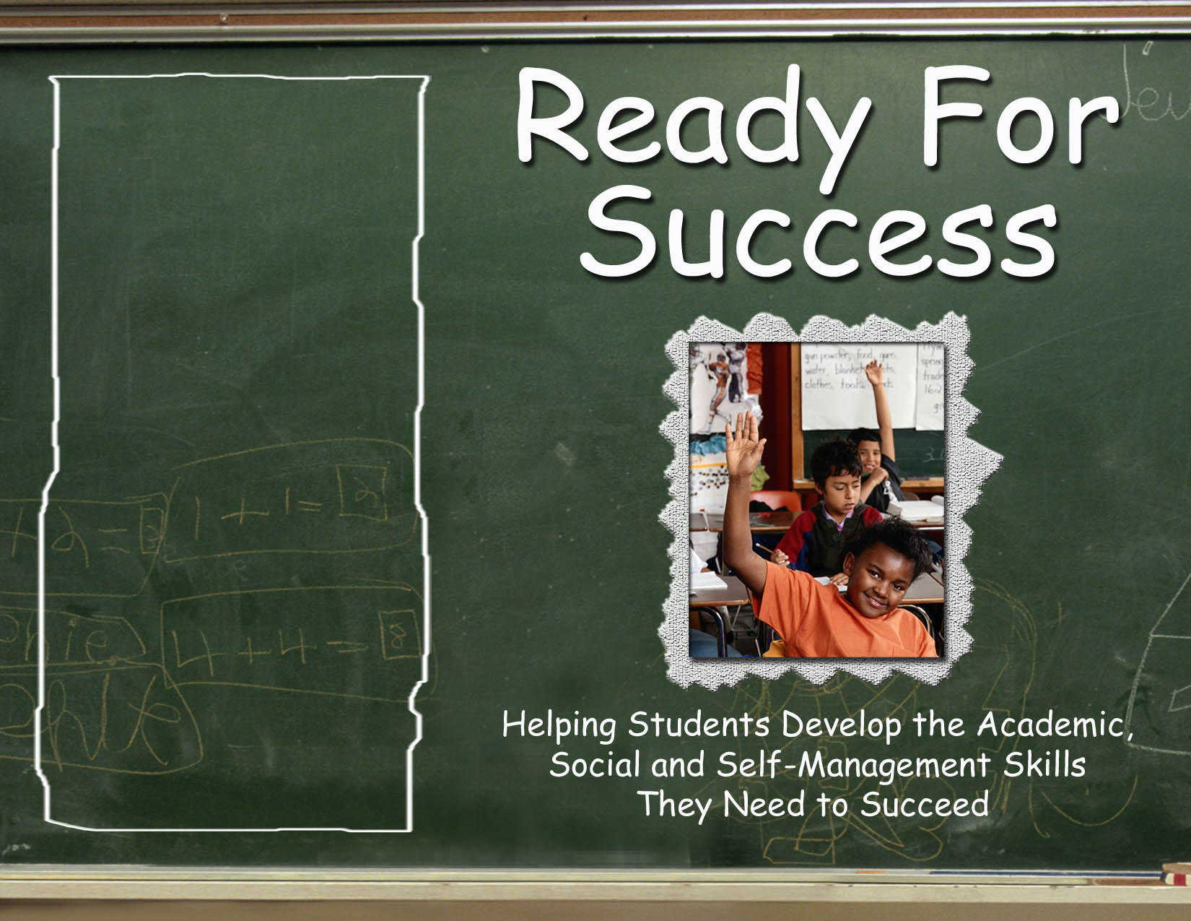
Greg Brigman, Ph.D.
Linda Webb, Ph.D.
Notes:
The Ready for Success Program was developed at Florida Atlantic University by Dr. Greg Brigman and Dr. Linda Webb. This classroom based program includes five lessons delivered one week apart and focuses on helping students in grades 2-3 develop key pre-requisite learning skills tied to school success.

Slide 2
Ready for Success Overview
Program Overview & Materials
Research Overview
Implementation of Lessons
Logistics & Planning
Questions & Wrap-up
Notes:
This RFS overview will give you an overview of the program and materials and research that supports the RFS program. Afterward if you would like to go through the curriculum you are welcome to do so.

Slide 3
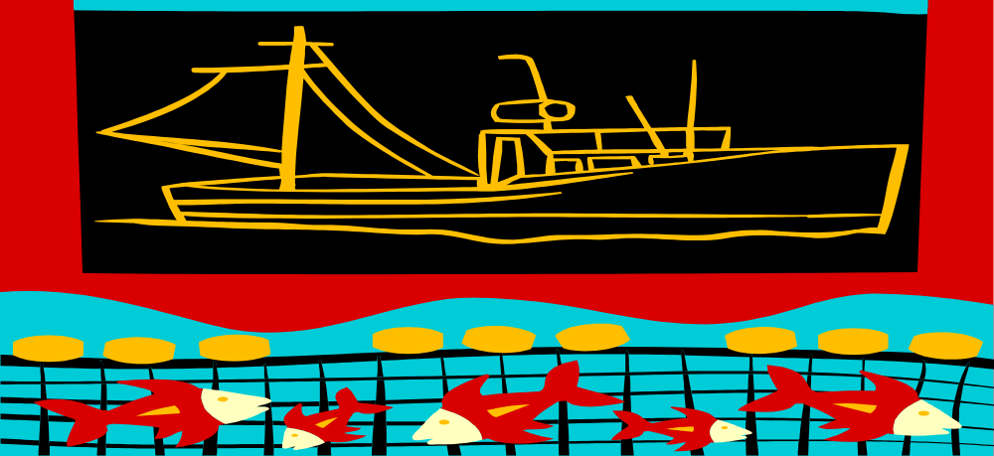
RFS: Embedding key skills and strategies into the daily curriculum to make the
“learning net” tighter.
Notes:
Fishing provides a metaphor for the RFS program.
Picture a fishing boat. If you are using a big net with big gaps to catch your fish, then when you pull in the catch you miss a lot of fish. Now picture another net with much smaller gaps. When you pull in this net you get many more fish. The fish are the curriculum you teach all year. The way to make the gaps in your students’ learning nets smaller is to add these key skills and strategies presented in the five lessons of the RFS program.
When your students use these new strategies and skills they are able to net more information easier and by the end of the year they not only know more but they know how to show what you know.

Slide 4
RFS Materials
  Manual Table of Contents
  CD with Five Lessons plus Booster Lesson
Notes:
Lets look at the manual. The table of content provides our road map for today. The introduction section behind the table of contents gives a brief overview of RFS and links it with the Ready to Learn and Student Success Skills programs. A short review of key research supporting all three programs is also provided and finally some links between RFS and SEL (Social Emotional Learning). Notice that after the introduction the first five sections are the five lessons of the RFS program. Each lesson has a timed overview on the front page then PowerPoint note pages that provide sample scripts to use to introduce the main ideas. Section six contains a booster lesson. The booster lesson helps refresh the key skills and strategies as spring testing draws near. The last section provides some tips on getting the most from the RFS program.
The CD in the front poach of the binder contains the five lessons plus the booster lesson.

Slide 5
Ready For Success
RFS is part of a three piece K-12 model
Ready to Learn PreK-1
Ready for Success 2-3
Student Success Skills 4-12
Notes:
RFS is part of a three component Pre-k-12 model called Student Success Skills. All three programs are aimed at helping your students develop key skills and strategies identified with those students who are successful in school. These skills and strategies are considered pre-requisites to learning the regular reading, math, science and social studies curriculum.
The RFS program is the newest edition to this Pre-K-12 model. The RTL program for Pre-K-1 and the SSS program for grades 4 and up have substantial research behind them. The RFS program has been successfully field tested in grades 2-3. Results from action research on the RFS program from 12 grade 2-3 classrooms mirrors the very positive results found in the seven randomized comparison group studies conducted with the RTL and SSS programs. Randomized comparison group studies on the RFS is being conducted currently on the RFS program.
To give you some idea of what to expect we offer research findings from the two sister programs: RTL and SSS.
All three programs build on the same positive research base.

Slide 6
Research Supporting RTL and RFS Program Development
Cartledge & Milburn (1978, 1996) reviewed literature correlating social skills with school achievement
Zemmelman, Daniels & Hyde (1993) reviewed best practices for teaching and learning
Wang, et al. (1994) reviewed 50 years of research on “What helps
US Department of Education (2003) Research on promoting literacy
Indicators of Early School Success (2004) indicators most frequently associated with later school success
Notes:
The RFS and RTL programs are based on extensive reviews of research on “the connection between social skills and achievement, best practices for learning and teaching, what helps students learn, research on promoting literacy and key indicators of early school success”.

Slide 7
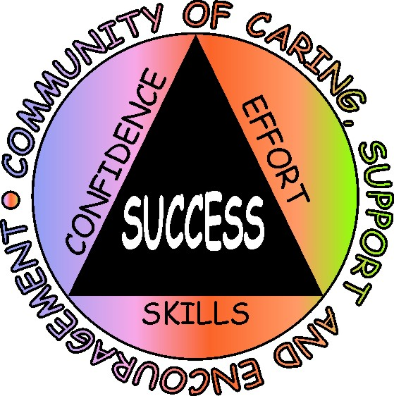
Research Base for Student Success Skills:
Five Key Reviews Of Research
Wang, et al. (1994)
Reviewed 50 years of research on “What helps students
learn”
Hattie, et al. (1996)
Reviewed 10 years of research on “The effects of learning skills interventions on student learning”
Masten & Coatsworth (1998)
Reviewed 25 years of research and identified “The most critical factors associated with academic and social competence”
Marzano, et al. (2001).
Reviewed 10 years of research on “Classroom instruction and
summarized research-based strategies for increasing student achievement “
Zins, et al. (2004).
Reviewed 10 years of research on “The relationship of social and emotional learning to academic success”
Notes:
The skills and strategies highlighted in the Student Success Skills program are very complimentary to the Ready For Success and Ready To Learn programs and were selected based upon the recurring dominant themes that emerged from the following five extensive reviews of research. The key skills and strategies featured in these same research reviews are reflected in the RFS program.

Slide 8
Skills associated with school achievement
  Attending – paying attention, being on task, and following directions
  Listening and reading comprehension – understanding the main idea, knowing when and how to ask questions and story structure
  Social skills – learning to be encouraging to self, to increase persistence, and work cooperatively with others
Notes:
The RFS and RTL programs share a focus on these three skill sets.

Slide 9

RTL Research
First Grade (1994)
Head Start (1999)
Kindergarten (2003)
800 children
ages 4-7
urban, suburban, rural settings
Significant & consistent positive findings in three targeted areas: listening, attending and social skills
Notes:
There have been three significant studies conducted on the RTL program.

Slide 10

Methodology and Analysis
Random assignment of classes to treatment and comparison groups
Standardized measures of achievement
  and behavior
Manualized intervention to insure treatment
  fidelity
Multiple settings
Analysis of Covariance used to
determine statistical significance
Replicated with consistent results
in all three studies
Notes:
The RTL research used very rigorous research design and analysis standards.

Slide 11

RTL Headstart research recognized as the “research article of the year” by the
Journal of Educational Research
Notes:
One indicator of the quality of the RTL research was a research award from a leading educational research journal.

Slide 12

Instruments
Stanford Early School Achievement Test: Listening Comprehension Subtest (SESAT2)
Comprehensive Teacher’s Rating Scale (ACTeRS)
Trained observers
Notes:
Significant differences were found on three separate measures for students who were taught the skills and strategies in the RTL program. Many of the RTL skills are included in the RFS program.

Slide 13
Student Success Skills
The SSS program focuses on 3 key skill sets:
  Cognitive skills
  Social skills
  Self-management skills
  The good news: These skills are teachable
Notes:
The SSS program includes the Ready To Learn skills of attending, listening/reading comprehension and social/cooperation skills within the categories of cognitive, social and self-management skills.
Ready for Success incorporates many of the skills from both the RTL and SSS programs.

Slide 14
RFS & SSS share 5 categories of skills and strategies
Goal setting and progress monitoring
Creating a caring supportive and encouraging classroom environment
Cognitive and memory skills
Performing under pressure
Healthy optimism
Notes:
The three skill sets upon which the SSS program are based: Cognitive, social and self-management have been operationalized into these five categories. The RFS program share these five categories. The five RFS lessons introduce students to skills and strategies under these five headings.

Slide 15
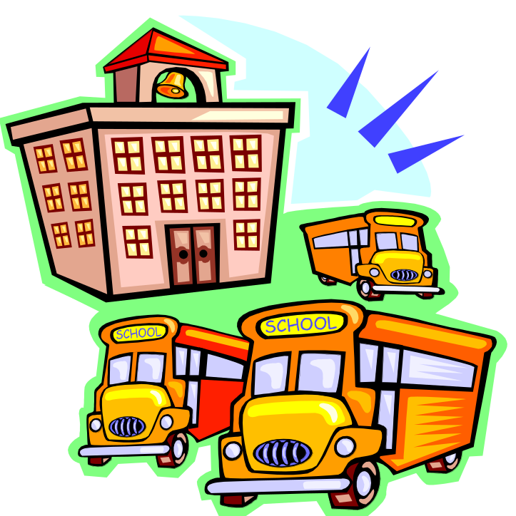
SSS Efficacy Research
Four studies
2000-2003
  50 school counselors
  36 schools - two counties
  Over 1100 students
  Grades 5,6,8,9
Notes:
Next I want to share key findings of four recent research studies involving the Student Success Skills program.

Slide 16
Evaluating Strong Evidence of
Effectiveness
Appropriate measures with high reliability and validity
Random assignment of treatment and comparison students
Statistical analysis of outcome variables with significance
Manualized intervention to insure implementation fidelity
Replication of intervention in similar populations with consistent results
Consistent results across diverse public school settings
Lasting impact
Notes:
The SSS research followed rigorous guidelines just a s the RTL research did.
And just as one of the RTL studies received an award for quality research, one of the SSS studies also received and award for outstanding group work research from the Journal for Specialists in Group Work.

Slide 17
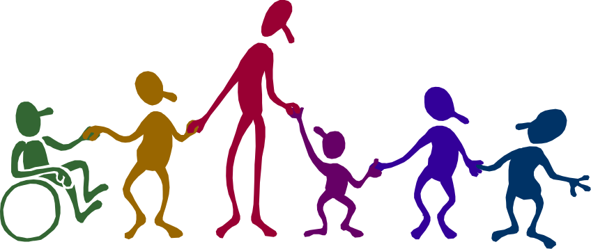
Attention to Diverse Populations
Urban
Suburban
Rural
White
Hispanic
African American
Notes:
The four studies included students that represent all of these categories. The ethnic makeup of students in the studies approximate the ethnic makeup of students across the country.

Slide 18
Consistent Findings:
FCAT math scores improved for approximately 86% of SSS students. Average increase was 30 points.
FCAT reading scores improved for approximately 78% of SSS students. Average increase was 25 points.
Follow-up study shows SSS students continue to make similar gains two years after participating in the program.
Notes:
On average approximately 9 out of every ten students who were presented with the SSS strategies showed improvement in math on the FCAT. The average gain was 30 points compared to the district and state averages of less than 5 points.
Approximately 8 out of every ten students receiving the SSS program improved in reading an average of 25 points while the district and state averaged less than 5 points.
One year later a follow-up study found the gains had not only been maintained but continued to grow at about the same rate as the first year in both areas.
These differences where significant in relation to the comparison students. Both treatment and comparison students were randomly selected from students who scored below the 50th percentile in math or reading.

Slide 19
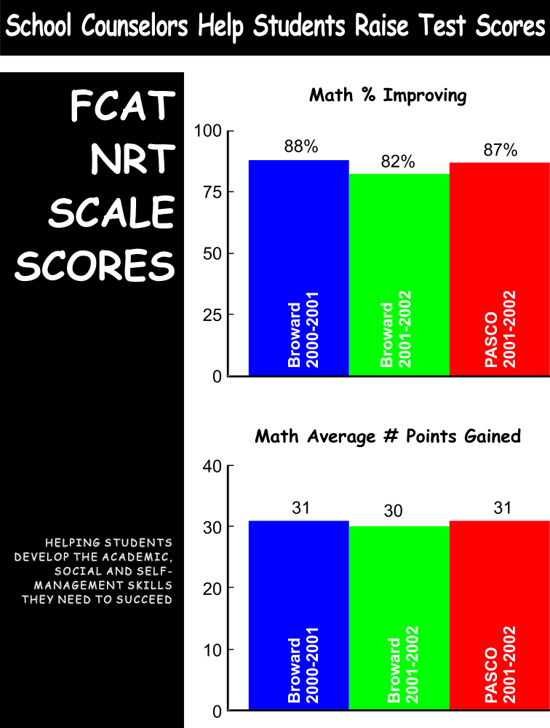
Notes:
This slide shows how consistent the results were across the 50 school counselors and 36 schools. Notice how similar the % of students who improved are as well as how similar the average points gained are. It is this type of consistency that provides extra confidence in the overall findings of these four studies.

Slide 20
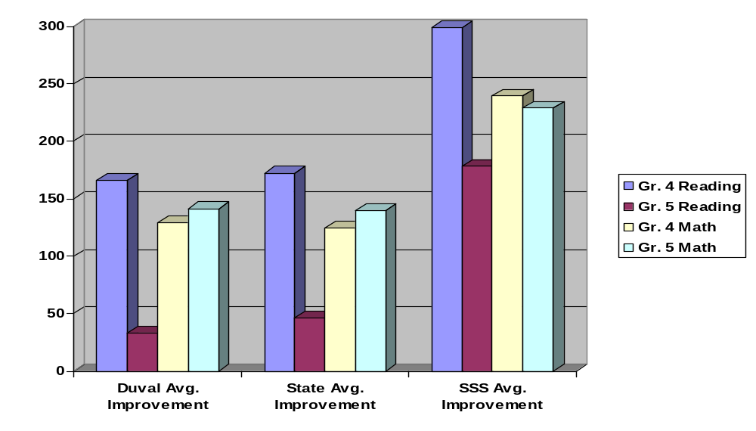
FCAT Developmental Scale Scores Comparison of Students Participating in Student Success Skills Program with Duval Average Improvement and State Average Improvement from 2005 to 2006
Student Success Skills results for 92 fourth grade students and 61 fifth grade students
who participated in at least 5 classroom guidance lessons and at least 5 small group
sessions in 11 schools.
Notes:
In addition to results from the four formal studies additional action research findings have been reported that mirror the results of the four randomized studies. This slide shows results from an action research report from a school counselor in Duval County, Florida. Students who are taught these strategies score better in math and reading than their counterparts who do not have them.

Slide 21
LeAnne’s School Evaluation:
G.W. Carver Elem--Duval County, FL
4th grade Read FCAT Scores
  21 students measured
  95% of students improved (19/20)
  Average SSS improvement was 307 points
  District average improvement was 141
4th grade Math FCAT Scores
  20 students measured
  90% improved (18/20)
  Average SSS improvement was 286 points
  District average improvement was 223
Notes:
This is another action research report from a separate Duval County school using the SSS program.

Slide 22
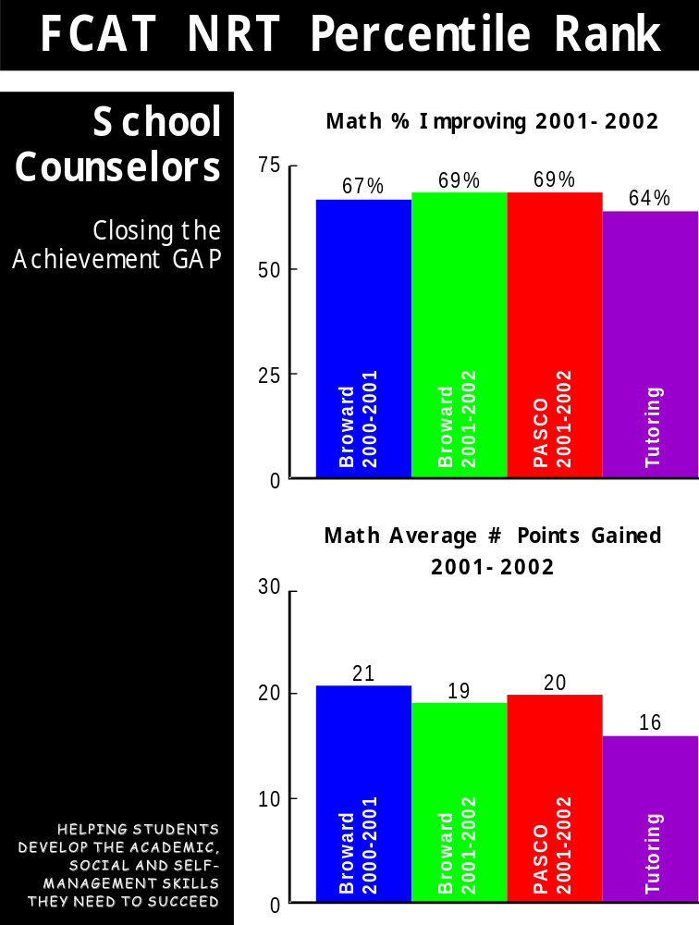
Notes:
Achievement gains for students receiving the SSS intervention were also compared to gains by students who participated in an intensive tutoring program in their school. The percentage of students who benefited from tutoring was similar to the percentage of SSS students showing improvement with the SSS students averaging slightly higher point gains.
The point is that the SSS strategies have similar power to impact achievement test scores as intensive tutoring.

Slide 23
SSS & Tutoring Intervention
The SSS students had gains comparable to an intensive tutoring program. The tutoring program: 44 hours led by certified teachers.
The SSS program: 12 hours (5 weekly classroom lessons followed by 8 weekly small group lessons) by school counselors.
Notes:
The SSS strategies provide a similar positive impact on test scores as an intensive tutoring program at considerably less cost and time. The cost of the type of tutoring program used in this comparison was is approximately $1000 per student for 44 hours of tutoring and this cost is recurring each year. The cost of delivering the SSS program is a one time cost for manual and training of approximately $5 per student and this cost is not recurring.

Slide 24

SSS and Student Behavior
Teacher Ratings
Nationally normed rating scale targeting skill areas involved in the SSS program
70% of students improved
Average improvement of 20 percentile points
Notes:
Teachers reported improved behavior for students participating in the SSS intervention. As students begin to acquire the skills and confidence necessary for academic success their behavior also improves. This observation was mirrored by teachers using the Ready for Success program in field tests recently.

Slide 25
SSS: Teacher Feedback
Percent of teachers rating the seven items below on their degree of helpfulness:
Lesson addresses need 100%
Students enjoyed 98%
Students understood/applied 93%
Develops learning/social skills 93%
Involved all students 98%
Age appropriate 98%
Classroom management skills 100%
(Based on 45 teachers responding)
Notes:
Teachers who have experienced/observed the facilitation of the SSS program have shown consistent support for the program. In one survey a group of 45 teachers were asked to rate teach of the above items on a one to five “Likert” type scale with 1 being low and 5 being high. The percentages represent teacher ratings of 4 or 5.

Slide 26

Research Summary
School counselor led groups focused on Student Success Skills help students to improve academic achievement and behavior
  Four studies with consistent findings
  Significant gains in reading, math, and behavior
  Randomized controlled trials
  Multiple settings/grade levels
  Helping to close the achievement gap at all levels
Notes:
There is strong evidence to support the Student Success Skills program as an evidence based intervention improving the academic and social competence of students.
You also saw earlier the same type of strong evidence for the Ready to Learn program.
The Ready for Success program builds on the success of the SSS and RTL programs and brings the most powerful strategies to second and third graders.

Slide 27
Three Keys to
Building Resilience and Reducing School Failure
Skills: Cognitive, Social and Self-management
Attitudes: Healthy Optimism, Solution Focused and Kaizen
Climate: Caring, Support, Encouragement
Notes:
The combination of research identified skills, attitudes and classroom climate is the heart of the all three of the Student Success Skills programs: RTL. RFS and SSS. The skills, attitudes and climate strategies embedded in these programs can significantly improve your students academic and social performance this year.

Slide 28
Key Skill Areas for
RFS and SSS
Goal setting and progress
monitoring
Creating a caring, supportive and encouraging classroom
Cognitive/Memory skills
Performing under pressure:
Managing test anxiety
Building Healthy Optimism
Notes:
The Ready for Success and Student Success Skills programs are based on five key skill building areas. Embedded within each of these are specific skills and strategies students can learn to use to help them achieve academic and social success. The following slides highlight some of these key skills and strategies.

Slide 29
Optimism
One of the greatest predictors of student academic success is their level of healthy optimistic thinking.
Seligman (1995)
Notes:
Being optimistic about what you can accomplish is important. Read quote.

Slide 30
Optimism Can Be Learned
We can help students learn optimism by teaching them to:
Use cognitive, social and self- management strategies
Set realistic goals
Notice even small improvements
Outcome: Students see that what they do
makes a difference and become more
optimistic and resilient.
Notes:
The Ready for Success program builds in opportunities for students to learn to be optimistic about their ability and to set realistic goals, monitor their progress, notice small improvements, try new strategies if they are not being successful and to share the strategies that are working with classmates.

Slide 31

What do they have in Common?
“Don’t let what you can’t do stop you from what you can do.”
Pat Summit John Wooden
UT UCLA
Notes:
Pat Summit and John Wooden are the all time winningest coaches in NCAA basketball.

Slide 32
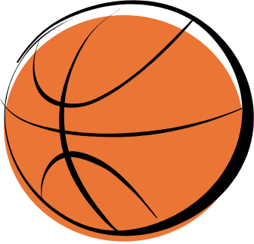
Fundamentals and Teamwork
Your playbook alone will not get you there.
You must work on fundamentals and teamwork everyday.
Notes:
Both coaches would spend time at each practice on fundamentals and teamwork. They considered both to be essential to their teams success. In education the curriculum is the playbook. If we want our students to master the playbook we must insure they have fundamental and teamwork skills that have clearly been identified as necessary for school success. The Ready for Success program helps your students to develop or deepen these critically important skills.

Slide 33
Begin with the End in Mind
Sometimes you have to
Go Slow
  To Go Fast
Notes:
It takes a little time to introduce these fundamentals and teamwork skills to your students. But if you want them to go fast in their learning this year, you need to slow down enough to make sure they have what they need to master the curriculum.

Slide 34
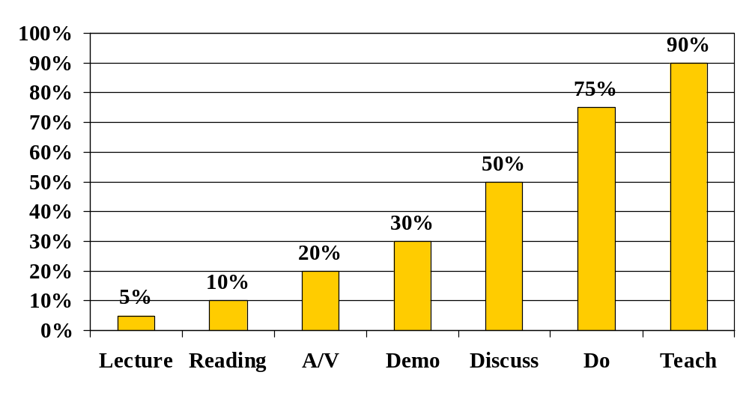
Retention of Material After 24 Hours
Conyers, M., & Wilson, D. (2000). BrainSMART Strategies
for Boosting Test Scores. Orlando, FL: BrainSMART Publishing.
Notes:
The SSS and RFS programs uses a multi-modal approach to teaching and emphasizes student interaction with structured student success sharing, and cooperative learning and coaching. This type of teaching has been repeated shown to engage students in learning and to facilitate rapid progress and improvement.

Slide 35
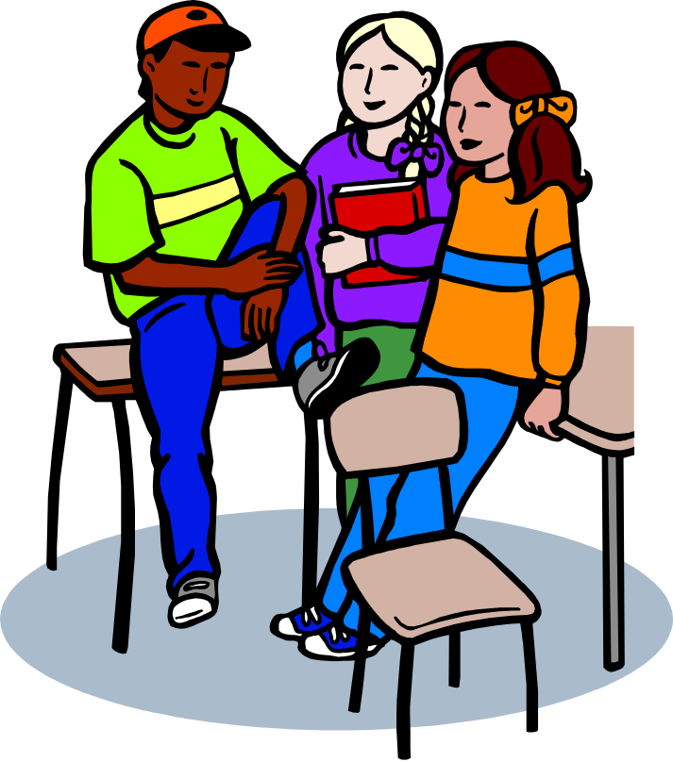
Classroom Component
Five classroom lessons
Beginning in the fall
Followed by monthly booster lessons in January – up to standardized testing
Notes:
The RFS program involves five classroom lessons of approximately 30 minutes. We encourage you to use our booster session as spring testing gets closer. We also encourage you to begin the RFS program as soon as possible to set your students up for success from the beginning of this year.

Slide 36
Pair Shares & Information Processing
Ah ha’s – New ideas, awareness, insight
Ta da’s – Validation of beliefs or strategies with which you have already had success
Questions for clarification
Notes:
Please take a moment to reflect on what you have seen and heard and share with a partner some of the most important ideas, and any examples of things you have already been doing that you found supported. If you have any questions this is a good time to clarify them as well.

